Slide 1
Sustainability at the IES
Notes:
Introduce yourself, when you joined the IES and your role (Sustainability and environmental impact, EDI, innovation etc.)

Slide 2
Sustainability Principles
“In a sustainable society, nature is not subject to systematically increasing…
1… concentrations of substances from the earth’s crust (such as fossil CO2, heavy metals and minerals)
2… concentrations of substances produced by society (such as antibiotics and endocrine disruptors)
3… degradation by physical means (such as deforestation and draining of groundwater tables).
4. And in that society there are no structural obstacles to people’s health, influence, competence, impartiality and meaning.”
https://thenaturalstep.org/approach/
Notes:
What is sustainability?
No increasing
1. levels of extraction of resources;
2. amounts waste produced by society; and
3. physical degradation
… and in that society…
4. people should have inclusive, equitable access to health, work, education, livelihoods and lifestyles

Slide 3
Becoming sustainable
A – Awareness
B – Baseline Assessment
C – Creative Solution
D – Devising a Plan
https://thenaturalstep.org/approach/
Notes:
Awareness
Everything starts with awareness. We need to understand how to define sustainability and what it means in the context for individuals, business and other organizations, society, and ultimately the Earth. We follow the Natural Step Framework as a science-based and ‘whole-systems’ definition as a firm foundation to build a vision of what success looks like in the future. It’s down to your organisation to define what sustainability means to you and how you wish to address it.
Baseline assessment
This step uses the four sustainability principles to conduct a sustainability ‘gap analysis’ of the major flows and impacts of the organisation to see how its activities are running counter to sustainability principles. This assesses the business to identify critical sustainability issues, their business implications, and strategic opportunities for change. It’s not about being perfect right from the get go, but having an honest assessment, promoting the sustainable practices already being applied and address the non-sustainable practices.
Creative solutions
Now that we have identified the gap between where we are today (current reality) and where we want to go (vision), we can start to think about innovations and solutions. These will bring us step by step closer to sustainable practice. We are clear on what success looks like, and which process we must set up or change in order to get us there.
Devise a plan
What do we need to do, and when should we do it? What are the first steps and “low hanging fruit” that will bring quicker benefits, and what needs longer term planning?

Slide 4
Assessment
Key areas:
Energy and lighting
Equipment and consumables
Food and waste
Supplies and suppliers
Business travel and commuting
Equity
Access
Engagement
Notes:
The assessment is broken down into the 4 principles but in essence these are the key areas

Slide 5
Actions already taken
Switched to a 100% renewable energy supplier
Transitioning to LED lighting
Developed sustainable, accessible event venue selection criteria
Online events
Developed travel policy that promotes sustainability
Switched to vegetarian/vegan catering
Staff voluntary changes
Use of First Mile
Use of second-hand or reconditioned products
Encouraging opt-outs of postal correspondence
Calculated our business GHG emissions
Signatories to net zero and carbon neutrality commitments
Science Council DEI framework
EDI Strategy 2020 - 2023
Notes:
Energy mix; 9% hydro, 40% solar, 51% wind
Bulbs are replaced as they break, rather than all out replacement due to wastage
Event criteria includes hearing loops, accessibility and will include our own actions on this such as braille copy if requested, online access etc.
Food purchase is also reduced to avoid over-ordering
Staff switching to oat milk in the office, no plastic bottles, choice of cycling over public transport
Digitised membership pack and application processes
First Mile are a recycling waste management company with a zero-landfill policy. Non-recyclables are used towards green energy production instead.

Slide 6
Actions to be done
Smart meter
Flexible working
Renewable energy partnership
Student Ambassador Scheme
Environmental policies of our suppliers
No single-use plastic policy formalised
Audit of office consumables
Explore more sustainable lunch options
Look to “opt-in” system as opposed to “opt-out” for electronic copies
Translation options
IES website redesign, with accessibility in mind
Implement EDI strategy actions
Notes:
Student Ambassadors could deliver talks on behalf of the IES, reducing travel costs
Translation options refers to commonly accessed pages/documents – investigating the most common first languages of cohorts accessing these

Slide 7
Commitments

Slide 8
Pledge to Net Zero
Context
Paris Climate Agreement – 1.5C pre-industrialised levels
Commitment to bringing GHGs to net zero by 2050
4/5 of the world’s largest companies unlikely to meet this
https://www.pledgetonetzero.org/
Notes:
Paris Climate Agreement – United Nations Framework Convention on Climate Change (UNFCCC) Conference of the Parties (COP21) December 2015 – limit rising temperatures to 1.5C pre-industrial by 2050 (or at least a well below 2C)
June 2019 UK Government committed to the 2050 target

Slide 9
Pledge to Net Zero
Set and commit to deliver a greenhouse gas target in line with either a 1.5°C or well below 2°C climate change scenario – covering buildings and travel as a minimum
Publicly report greenhouse gas emissions and progress against this target each year
Publish one piece of research/thought-leadership each year on practical steps to delivering an economy in line with climate science and in support of net zero carbon. Alternatively, signatories may choose to provide mentoring and support for smaller signatory companies in setting targets, reporting and meeting the requirements of the pledge
https://www.pledgetonetzero.org/

Slide 10
Calculating GHG emissions
Scope 1: Direct GHG emissions occurring from sources that are owned or controlled by the company, for example, emissions from combustion in owned or controlled boilers, furnaces, vehicles, etc.; emissions from chemical production in owned or controlled process equipment.
Scope 2: Indirect greenhouse gas emissions from consumption of purchased electricity, heat or steam.
Scope 3: Other indirect emissions, such as the extraction and production of purchased materials and fuels, transport-related activities in vehicles not owned or controlled by the reporting entity, electricity-related activities (e.g. transportation and distribution losses) not covered in Scope 2, outsourced activities, waste disposal, etc.
https://ghgprotocol.org/
Notes:
To set our GHG target, we had to first calculate our GHG emissions.

Slide 11
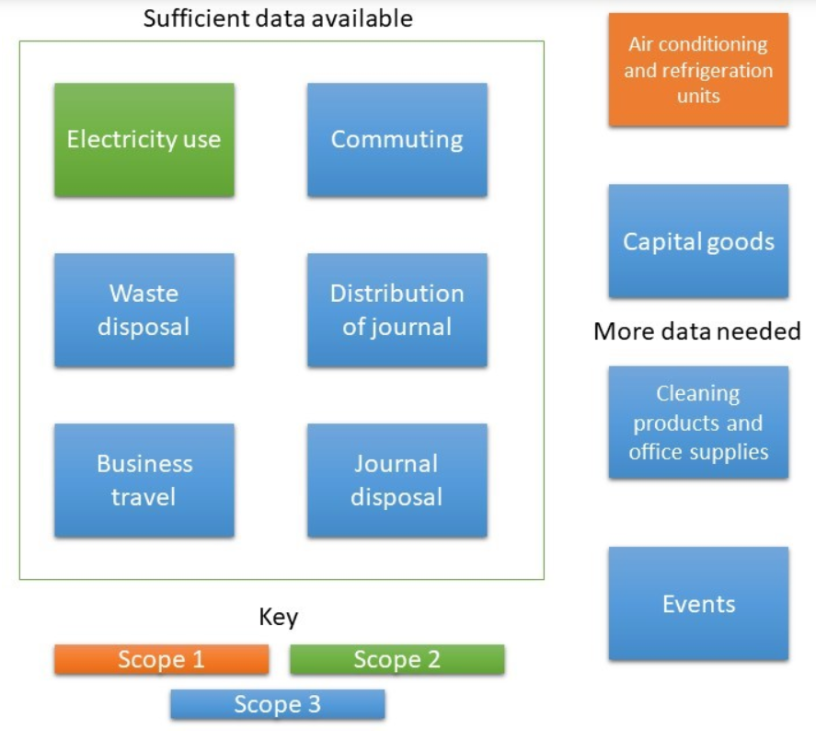

Slide 12
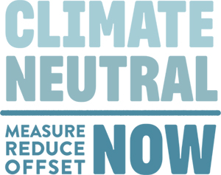
UNFCCC Climate Neutral Now
Measure and report their greenhouse gas emissions for an agreed-upon period of time
Reduce their greenhouse gas emissions as much as possible
Offset remaining emissions with UN Certified Emission Reductions (CERs).
https://unfccc.int/climate-action/climate-neutral-now
Notes:
This achieves climate neutrality, not just a reduction in emissions

Slide 13
Links
Natural Step - https://thenaturalstep.org/approach/
Pledge to Net Zero - https://www.pledgetonetzero.org/
UNFCCC Climate Neutral Now - https://unfccc.int/climate-action/climate-neutral-now
GHG Protocol - https://ghgprotocol.org/
IES - https://www.the-ies.org/news/environmental-and-sustainability-audit-2020 & https://www.the-ies.org/analysis/ies-GHG-emission-targets

